Slide 1
WP2 Building pathology – progress
By Henk Vermande
Forum meeting 6, DG ENTR, Brussels

Slide 2
Outline
Program of work and planning
Pathology database
Business models for the operation of a future pathology database (EQEO)

Slide 3
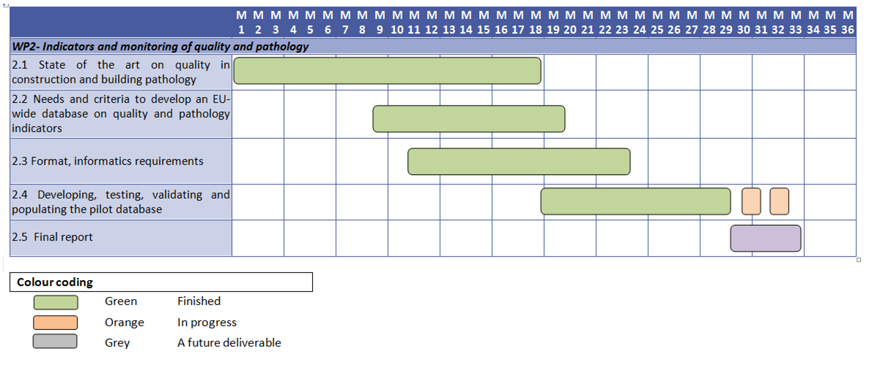
Planning

Slide 4
Populating the database
Cases were provided by the project partners (NHBC, CSTB, SBi, BBRI, ARCADIS, TSUS) from a variety of sources:
  The ten cases on eco-technologies
  Public internet sources
  Collected experience from test institutes and research institutes

Slide 5
Eco-technology | Number of cases | Countries covered
Heat pumps | 19 | Ireland (3x), UK (1x), Bulgaria (1x), Poland (1x), Spain (1x), France (5x), UK (10x), Netherlands (1x)
Insulation made of bio-materials. | 20 | Denmark (2x), France (7x), UK (8x), Netherlands (2x), Czech Rep. (1x),
PV-panels | 24 | Greece (1x), Spain (1x), France (11x), Germany (1x), Netherlands (3x), Denmark (1x), UK (9x),
Solar hot water | 1 | Poland (1x)

Slide 6
Some findings
Hardly any detailed project-related pathology
Mostly collected experiences and lessons-learned
Field most often used: “general description of the pathology”
→ number of input fields are not used
Distinction between defect and failure is, and remains difficult

Slide 7
Business models for the future database/EQEO
Operation on a non-profit basis with free public access
Operation on a (semi-)commercial basis with access on a subscription basis
Operation on a ‘give-and-take’ basis with limited access to a group of partners

Slide 8

Cost elements
Input
Output
Database / EQEO
Collecting defects
Inspectors?
Secretariat
Database manager
Evaluation and analysis of data
Making publications / disseminating information
Reviewing methodology and registration method

